Slide 1
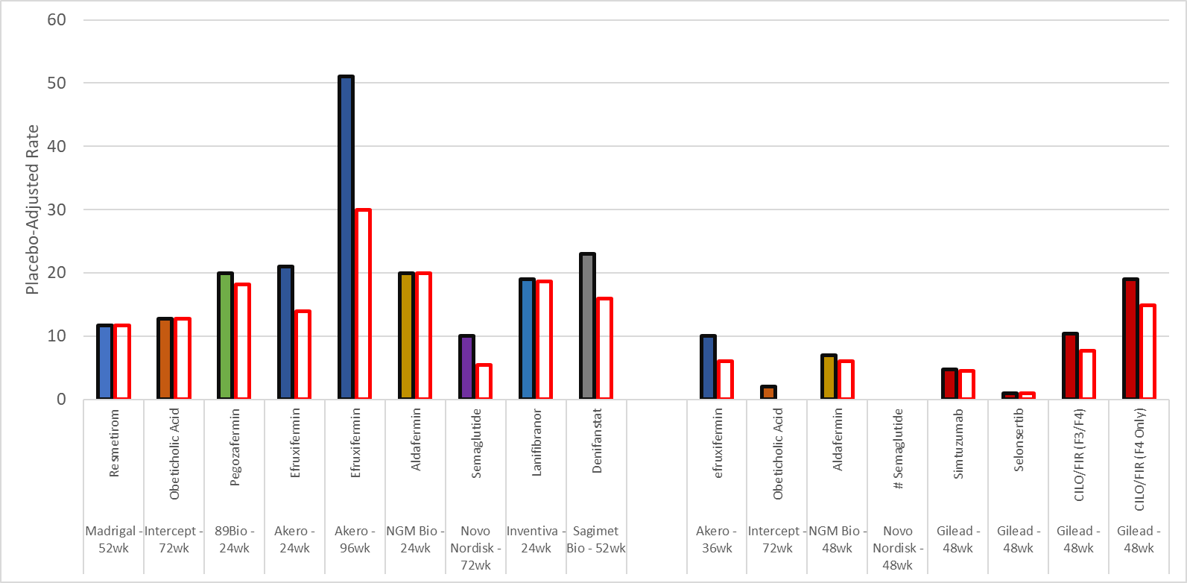
Fibrosis Improvement – Reported Results and NRI Analyses
Non-Cirrhotic NASH
Cirrhotic NASH
Reported Results
NRI Analysis
Companies commonly highlight observed case analysis in press releases which inflates rate of fibrosis improvement
Resmetirom was approved based on an NRI analysis. Additional NRI analyses are shown in red outlined bars
# placebo-adjusted result below zero
Notes:
Jason

Slide 2
Cirrhosis regression following effective therapy on average takes > 1 year
1- and 5-yr biopsies in the open label extension of tenofovir disoproxil fumarate showed appreciable cirrhosis regression only at year 5
Marcellin, P., et al. (2013). "Regression of cirrhosis during treatment with tenofovir disoproxil fumarate for chronic hepatitis B: a 5-year open-label follow-up study." The Lancet 381(9865): 468-475.
HCV Cure monitoring demonstrates a strong time dependence for observing cirrhosis regression by NITs, though minimal data is available before 72 weeks
Dunn, W., et al. (2021). Cirrhosis regression based on both Enhanced Liver Fibrosis (ELF) and Fibrotest after Direct-acting Hepatitis C therapeutics corresponds to a lower incidence rate of hepatocellular carcinoma below the cost-effective threshold for surveillance. EASL.
Bariatric surgery in NASH patients evaluated at 5 years showed minimal cirrhosis regression and a strong association with time since surgery among the overall advanced fibrosis cohort
Pais, R., et al. (2022). "Persistence of severe liver fibrosis despite substantial weight loss with bariatric surgery." Hepatology 76(2): 456-468.
Lassailly, G., et al (2020) “Bariatric Surgery Provides Long-term Resolution of Nonalcoholic Steatohepatitis and Regression of Fibrosis” Gastroenterology, 159; 1290-1301
Cirrhosis regression is likely a time-dependent phenomenon with no evidence to suggest appreciable regression occurring within 1 year
Notes:
Jason

Slide 3
Go/No-Go Decision Framework
Will be applied to
CILO/FIR+SEMA vs Placebo
CILO/FIR vs Placebo
Level 1
Primary Endpoint & Safety
Consider
Go
No-Go
Level 2
Selected Critical Endpoints
Go
No-Go
Notes:
Xiaomin

Slide 4
Level 1 Go/No-Go Criteria (Same Procedure for Triple vs PBO and CILO/FIR vs PBO)
The Level 1 treatment effect of Triple vs Placebo and CILO/FIR vs Placebo will be evaluated in parallel procedures
 | Go | Consider | No-Go
Primary Endpoint: Fibrosis improvement without worsening of NASH (% responders) | Meet Go criteria based on 3-zone framework for either primary or sensitivity analysis⁺ | Meet both for either primary or sensitivity analysis⁺: 1-sided p ≤ 0.05#, and Consider criteria based on 3-zone framework | Meet at least one for primary and sensitivity analysis⁺: 1-sided p > 0.05#, or No-Go criteria based on 3-zone framework
 | - AND - | - AND - | - OR -
Safety | No significant imbalance in serious safety concerns* that are unfavorable for the treatment arm | No significant imbalance in serious safety concerns* that are unfavorable for the treatment arm | Significant imbalance in serious safety concerns* that are unfavorable for the treatment arm
⁺ The primary analysis is with RBI, or NRI when applicable, and sensitivity analysis is with OC.
# Using less stringent bar of 0.05 for 1-sided p-value is due to insufficient power for detecting treatment effect that may result from 1) possibility of ~20% dropout; and 2) evolving standard for meaningful efficacy compared to study design (23% → 15%)
* Key serious safety concerns include, but not limited to imbalance in treatment-related SAEs, treatment-related discontinuations, treatment-related AE with G3+, lab abnormalities with G3+, DILI/hepatoxicity, triglyceride or lipid elevations requiring discontinuation or additional lipid-lowering agents, gallbladder disease, malignancy, and SEMA-related (MACE, malignancy, secondary AKI, worsening nutritional status driving decompensation)
Notes:
Xiaomin

Slide 5
Ph2b Power for Fibrosis Improvement
Using less stringent bar of 0.05 for 1-sided p-value is due to insufficient power for detecting treatment effect that may result from
Possibility of ~20% dropout; and
Evolving standard for meaningful efficacy compared to study design (23% → 15%)
Dropouts | True Tx Effect | 1-Sided Alpha
Dropouts | True Tx Effect | 0.025 | 0.05
10% | 15% | 68.7% | 79.9%
 | 20% | 88.6% | 94.1%
15% | 15% | 65.6% | 77.2%
 | 20% | 86.2% | 92.6%
20% | 15% | 62.3% | 74.1%
 | 20% | 83.5% | 90.8%
25% | 15% | 58.9% | 70.8%
 | 20% | 80.5% | 88.6%
3:2 randomization; Placebo Rate = 12%; Missing data imputed with non-responder imputation method (NRI)
Notes:
Xiaomin

Slide 6
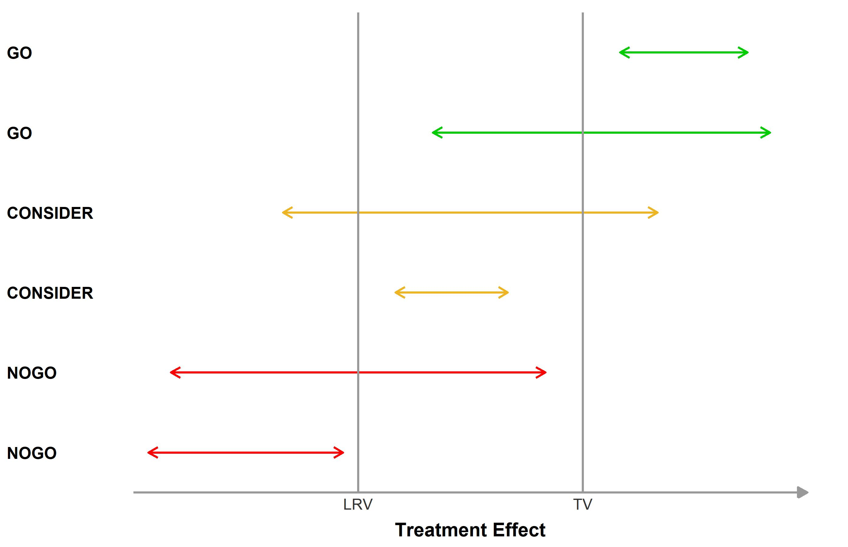
3-Zone Decision Framework
Key Parameters
Compares confidence interval (CI) to TV/LRV
TV: Target Value of treatment effect
Usually linked to TPP and is commercial driven
LRV: Lower Reference Value of treatment effect
Minimum accepted value
“False go” rate
Go decision when true effect is LRV or worse
Lower bound of 1-sided CI
“False stop” rate
Stop decision when true effect is TV or better
Upper bound of 1-sided CI
If could be at least as good as TV and likely to be better than LRV
If could be at least as worse as LRV and unlikely to achieve TV, then stop
The risk that the team could tolerate

Slide 7
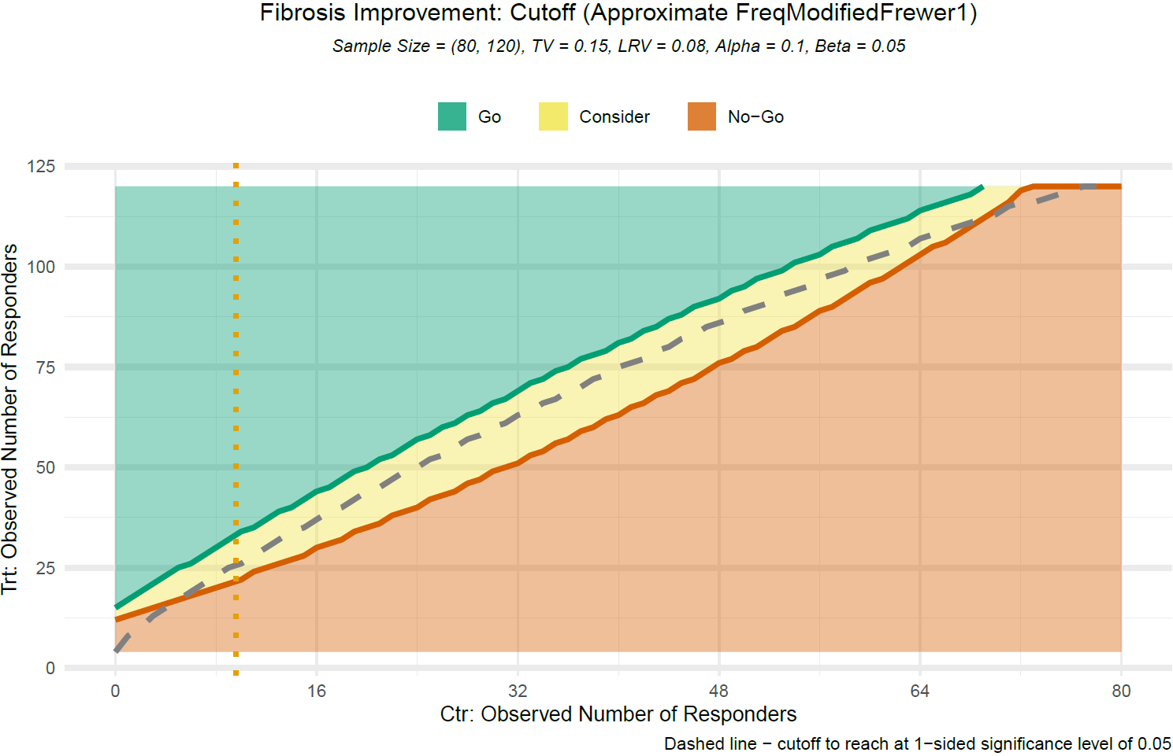
3-Zone Decision Method – Fibrosis Improvement w/o worsening of NASH
Obs Resp in Placebo (N = 80) | Obs Treatment Effect vs PBO |  |  | Prob of Success (PoS)* of Ph3
Placebo Resp | No-Go (≤) | Go (≥) | 1-Sided P ≤ 0.05 (≥) | No-Go (≤) | Go (≥) | 1-Sided P ≤ 0.05 (≥)
8 ( 10.0%) | 6.7% | 15.0% | 9.2% | 44.5% | 89.1% | 63.4%
10 ( 12.5%) | 5.8% | 15.8% | 9.2% | 41.1% | 88.7% | 59.5%
12 ( 15.0%) | 5.8% | 15.8% | 10.0% | 31.4% | 84.5% | 57.3%
16 ( 20.0%) | 5.0% | 16.7% | 10.8% | 29.0% | 85.9% | 61.1%
20 ( 25.0%) | 4.2% | 16.7% | 11.7% | 24.0% | 83.7% | 65.6%
LRV = Δ8%, TV = Δ15%; false-go = 0.1, false-stop = 0.05; decisions are based on observed data
* PoS was computed using Bayesian method to estimate the likelihood of success of the Ph3 study using data observed from current Ph2, where Ph2 was with sample size of 120:80 and 20% dropout, and Ph3 assumes the following design: N = 488, 3:2 randomization, 10% dropout and 2-sided alpha = 0.01. Missing data were imputed with NRI method. Beta priors, i.e Beta(0.12, 0.88) and Beta(0.22, 0.78) for response rates in placebo and treatment, respectively, were considered.
Notes:
Xiaomin

Slide 8
Level 2 Go/No-Go Criteria (Procedure for Triple vs PBO)
 | Consider Criteria – Consistency Across Biomarkers
Histologic endpoints | Consistent change with at least one of the following with 1-sided p ≤ 0.05⁺ Fibrosis improvement in PathAI AIM-NASH CRN (final score, % responders) PathAI proportion of fibrosis area over tissue
 | - OR
Orthogonal Measures of Fibrosis Improvement | Consistent change with at least two of the following with 1-sided p ≤ 0.05⁺ ELF: ≥ 0.5 reduction¹ (more patients with improvement in %) or ≥ 0.5 increase¹ (less patients with worsening in %) FIB-4: ≥ 15% relative reduction (% responders) LS by FibroScan: ≥ 5 kPa reduction² (% responders) or ≥ 20% relative reduction² (% responders) SomaSignal fibrosis test changes vs. Placebo ^{3, 4}
⁺ For primary analysis (with RBI or NRI) or secondary analysis (with OC)
¹ Sanyal et al 2021; ² Loomba et al 2022; ³ Vali et al. 2023; ⁴ Sanyal et al. 2023; ⁵ Sanyal et al. 2023
Notes:
Andrew

Slide 9
Level 2 Go/No-Go Criteria (Procedure for CILO/FIR vs PBO)
Consider
Triple vs SEMA (Confirmatory Evidence)
CILO/FIR vs PBO (Consistency)
Confirmation with at least one of the following with 1-sided p ≤ 0.05⁺
Fibrosis improvement without worsening of NASH (human read, % responders)
Fibrosis improvement in PathAI AIM-NASH CRN (final score, % responders)
Consistent change with at least one of the following with 1-sided p ≤ 0.05⁺
Fibrosis improvement in PathAI AIM-NASH CRN (final score, % responders)
PathAI proportion of fibrosis area over tissue
No
Yes
Yes
No
Go
Go
Consistent change with at least two of the followings with 1-sided p ≤ 0.05⁺
ELF: ≥ 0.5 reduction¹ (more patients with improvement in %) or ≥ 0.5 increase¹ (less patients with worsening in %)
FIB-4: ≥ 15% relative reduction (% responders)
LS by FibroScan: ≥ 5 kPa reduction² (% responders) or ≥ 20% relative reduction² (% responders)
SomaSignal fibrosis test changes (CILO/FIR vs. Placebo) ^{3, 4}
Yes
Guide
Triple vs SEMA biopsy analysis provides independent confirmation of the benefit of CILO/FIR, making it the strongest level of supporting evidence
Enhanced precision of PathAI in CILO/FIR vs PBO may overcome issues related to assessment noise and loss of power
Combination NIT assessment provides orthogonal support of biopsy result
No
No-Go
⁺ For primary analysis (with RBI or NRI) or secondary analysis (with OC)
¹ Sanyal et al 2021; ² Loomba et al 2022; ³ Vali et al. 2023; ⁴ Sanyal et al. 2023; ⁵ Sanyal et al. 2023
Notes:
Xiaomin

Slide 10
Supporting Slides: Treatment Effect Size

Slide 11
WAYFIND 454-6075 Assumptions Regarding Histologic Responses
Responders, % | Novo Ph 2b (F2-F3) |  |  | ATLAS Ph 2b (F3-F4) |  |  | STELLAR-3 (F3) | STELLAR-4 (F4) |  | Novo/Gilead Phase 2b (F4)
 | Placebo | SEMA 0.4 mg QD |  | Placebo n=38 | CILO/FIR n=78 |  | All Patients n=802 | All Patients n=877 |  | Placebo n~80 | SEMA n~120 | CILO/FIR n~120 | SEMA+ CILO/FIR n~120
Fibrosis improvement without worsening of NASH | 33 (19/58) | 43 (24/56) |  | 11 (4/38) | 21 (14/67) |  | 11 (91/802) | 13 (118/877) |  | 12% | 20% (+8%) | 27% (+15%) | 35% (+23%)
NASH resolution without worsening of fibrosis | 17 (10/58) | 59 (33/56) |  | 0 (0/38) | 4.5 (3/67) |  | 5 (44/801) | 3 (28/876) |  | 10% | 40% (+30%) | 15% (+5%) | 45% (+35%)
SEMA has reduced effect on both endpoints in F4 vs F1-F3
CILO+FIR has similar effects as in ATLAS (56% F4), with increase in fibrosis regression from 10% to 15% due to prolongation of treatment (72 vs 48 to weeks)
Histologic benefits of SEMA/CILO/FIR will be additive of the effects of SEMA and CILO/FIR vs placebo
Biological pathways are independent and data from POC and ATLAS are supportive
Novo Ph 2 (F4) | Novo Ph 2 (F4)
Responders, % | Placebo | SEMA 2.4 mg QD
Fibrosis improvement without worsening of NASH | 29 (7/24) | 11 (5/47)
NASH resolution without worsening of fibrosis | 21 (5/24) | 34 (16/47)

Slide 12
FIR+CILO (N=78) data from ATLAS Study (1/2)
Primary and Exploratory Endpoints (F4) | Difference in Proportion vs Placebo
Fibrosis improvement without worsening of NASH | 19.3%
≥2-Point Improvement in NAS | 25.1%
≥ 1-Grade Improvement in NAS Hepatic Steatosis | 34.1%
≥ 1-Grade Improvement in NAS Lobular Inflammation | 17.4%
≥ 1-Grade Improvement in NAS Hepatocellular Ballooning | 11.9%
Exploratory Endpoints (F3 & F4) | Difference in LS Means of Change (95% CI) vs Placebo
Hepatic Collagen Content | -0.7 (-3.0, 1.6)
Morphometric Fat Content | -3.5 (-5.9, -1.2)
ELF Score | -0.4 (-0.7, -0.0)
Liver Stiffness by TE | -3.1 (-6.6, 0.4)
Transient Elastography CAP | -6 (-31, 19)
FibroSure/FibroTest Score | -0.04 (-0.08, -0.00)
FIB-4 | -0.06 (-0.34, 0.23)
APRI | -0.1 (-0.2, 0.0)
NFS | 0.073 (-0.201, 0.347)

Slide 13
FIR+CILO (N=78) data from ATLAS Study (2/2)
Exploratory Endpoints (F3 & F4) | Difference in LS Means of Change (95% CI) vs Placebo
ALT | -11 (-21, -1)
AST | -8 (-16, 0)
GGT | -1 (-29, 26)
CY18M30 | -158 (-272, -43)
CY18M65 | -231 (-468, 5)
CRP | -0.028 (-0.210, 0.154)
Total Bile Acids | -4.5 (-7.7, -1.3)
Total Cholesterol | 17 (5, 29)
Triglycerides | 47 (21, 72)
HDL | -4 (-7, -1)
LDL | 9 (-1, 18)
Non-HDL | 19 (8, 31)
VLDL | 8 (4, 12)
Body Weight | -1.7 (-3.5, 0.1)

Slide 14
Supporting Slides: Go/No-Go Criteria

Slide 15
3-Zone Decision Method – Fibrosis Improvement w/o worsening of NASH
Obs Resp in Placebo (N = 80) | Obs Resp in Triple Combo (N = 120) |  |  | Obs Treatment Effect vs PBO |  |  | Prob of Success (PoS)* of Ph3
Placebo Resp | No-Go (≤) | Go (≥) | 1-Sided P ≤ 0.05 (≥) | No-Go (≤) | Go (≥) | 1-Sided P ≤ 0.05 (≥) | No-Go (≤) | Go (≥) | 1-Sided P ≤ 0.05 (≥)
8 ( 10.0%) | 20 ( 16.7%) | 30 ( 25.0%) | 23 ( 19.2%) | 6.7% ( 0.5%, 14.5%) | 15.0% ( 8.4%, 23.5%) | 9.2% ( 2.9%, 17.3%) | 44.5% | 89.1% | 63.4%
9 ( 11.3%) | 21 ( 17.5%) | 32 ( 26.7%) | 25 ( 20.8%) | 6.3% (-0.1%, 14.4%) | 15.4% ( 8.5%, 24.2%) | 9.6% ( 3.0%, 18.0%) | 45.1% | 88.9% | 63.5%
10 ( 12.5%) | 22 ( 18.3%) | 34 ( 28.3%) | 26 ( 21.7%) | 5.8% (-0.7%, 14.2%) | 15.8% ( 8.7%, 24.9%) | 9.2% ( 2.4%, 17.8%) | 41.1% | 88.7% | 59.5%
11 ( 13.8%) | 24 ( 20.0%) | 35 ( 29.2%) | 28 ( 23.3%) | 6.3% (-0.6%, 15.0%) | 15.4% ( 8.2%, 24.7%) | 9.6% ( 2.6%, 18.6%) | 42.1% | 86.6% | 64.2%
12 ( 15.0%) | 25 ( 20.8%) | 37 ( 30.8%) | 30 ( 25.0%) | 5.8% (-1.1%, 14.8%) | 15.8% ( 8.4%, 25.4%) | 10.0% ( 2.8%, 19.2%) | 31.4% | 84.5% | 57.3%
13 ( 16.3%) | 26 ( 21.7%) | 39 ( 32.5%) | 32 ( 26.7%) | 5.4% (-1.7%, 14.6%) | 16.3% ( 8.6%, 26.0%) | 10.4% ( 3.0%, 19.9%) | 28.7% | 84.8% | 58.2%
14 ( 17.5%) | 27 ( 22.5%) | 40 ( 33.3%) | 34 ( 28.3%) | 5.0% (-2.3%, 14.4%) | 15.8% ( 8.1%, 25.8%) | 10.8% ( 3.3%, 20.6%) | 26.3% | 82.7% | 59.1%
15 ( 18.8%) | 28 ( 23.3%) | 42 ( 35.0%) | 35 ( 29.2%) | 4.6% (-2.9%, 14.2%) | 16.3% ( 8.3%, 26.4%) | 10.4% ( 2.7%, 20.3%) | 27.7% | 83.1% | 56.1%
16 ( 20.0%) | 30 ( 25.0%) | 44 ( 36.7%) | 37 ( 30.8%) | 5.0% (-2.6%, 14.8%) | 16.7% ( 8.6%, 27.0%) | 10.8% ( 3.0%, 20.9%) | 29.0% | 85.9% | 61.1%
17 ( 21.3%) | 31 ( 25.8%) | 45 ( 37.5%) | 39 ( 32.5%) | 4.6% (-3.2%, 14.6%) | 16.3% ( 8.1%, 26.7%) | 11.3% ( 3.2%, 21.5%) | 26.8% | 84.2% | 62.2%
18 ( 22.5%) | 32 ( 26.7%) | 47 ( 39.2%) | 40 ( 33.3%) | 4.2% (-3.7%, 14.3%) | 16.7% ( 8.4%, 27.3%) | 10.8% ( 2.7%, 21.3%) | 24.7% | 84.7% | 59.4%
19 ( 23.8%) | 34 ( 28.3%) | 49 ( 40.8%) | 42 ( 35.0%) | 4.6% (-3.5%, 14.9%) | 17.1% ( 8.7%, 27.8%) | 11.3% ( 3.0%, 21.9%) | 26.0% | 85.4% | 60.6%
20 ( 25.0%) | 35 ( 29.2%) | 50 ( 41.7%) | 44 ( 36.7%) | 4.2% (-4.0%, 14.7%) | 16.7% ( 8.2%, 27.5%) | 11.7% ( 3.3%, 22.4%) | 24.0% | 83.7% | 65.6%
LRV = Δ8%, TV = Δ15%; false-go = 0.1, false-stop = 0.05; decisions are based on observed data; CI was constructed in consistent with the 3-Zone decision framework
* PoS was computed using Bayesian method to estimate the likelihood of success of the Ph3 study using data observed from current Ph2, where Ph2 was with sample size of 120:80 and 20% dropout, and Ph3 assumes the following design: N = 488, 3:2 randomization, 10% dropout and 2-sided alpha = 0.01. Missing data were imputed with NRI method. Beta priors, i.e Beta(0.12, 0.88) and Beta(0.22, 0.78) for response rates in placebo and treatment, respectively, were considered.

Slide 16
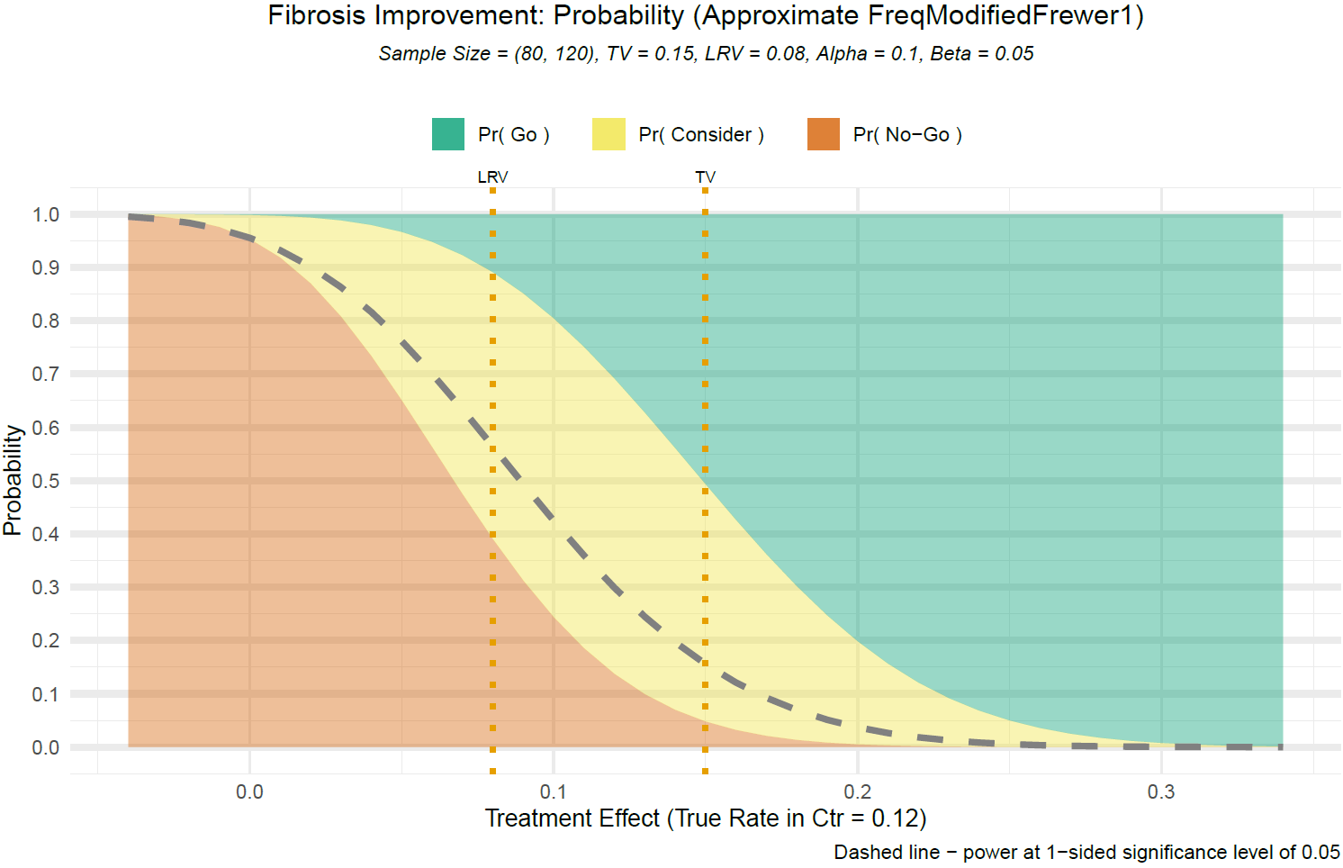
3-Zone Decision Method – Fibrosis Improvement w/o worsening of NASH
Dropout | True Effect (Rate Difference) | Probability of Decision for a given True Effect |  |  | Power (1-Sided P ≤ 0.05)
 |  | Go | Consider | No-Go
No | Great (TV = Δ0.15) | 50.7% | 44.6% | 4.8% | 84.4%
 | Minimal (LRV = Δ0.08) | 10.9% | 50.1% | 39.0% | 43.6%
 | No Effect (Δ0) | 0.1% | 4.5% | 95.3% | 4.5%
20% | Great (TV → Δ0.12) | 30.8% | 55.4% | 13.7% | 70.1%
 | Minimal (LRV → Δ0.064) | 6.1% | 41.2% | 52.7% | 32.6%
Treatment (n = 120) vs Placebo (n = 80); Placebo rate = 12%
LRV = Δ8%, TV = Δ15%; false-go = 0.1, false-stop = 0.05

Slide 17
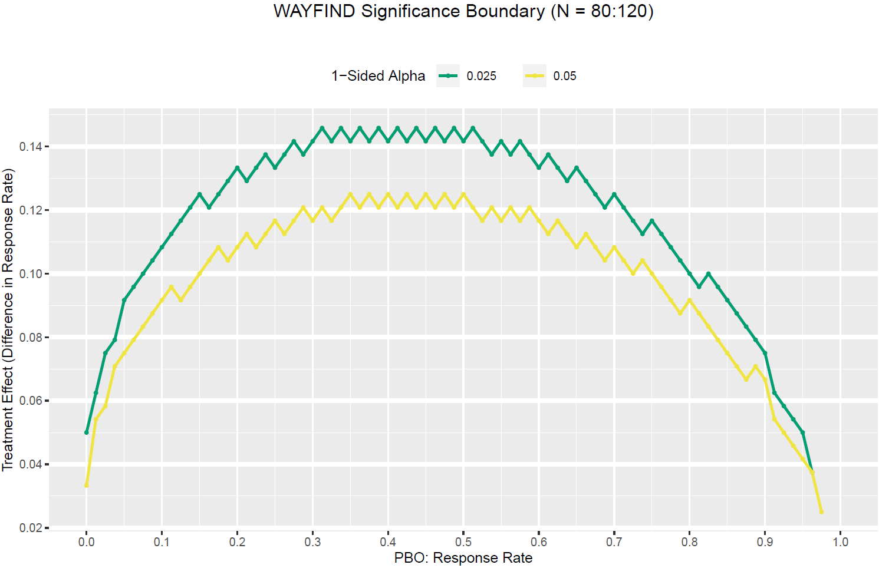
3-Zone Decision Method – Fibrosis Improvement w/o worsening of NASH

Slide 18
Phase 2b Study Design – Testing Strategy
Single primary endpoint
PE: Fibrosis improvement without worsening of NASH triple vs placebo
SE1: Fibrosis improvement without worsening of NASH triple vs SEMA
SE2: NASH resolution triple vs placebo
SE3: NASH resolution triple vs CILO/FIR
Meet PE: 2-sided P < 0.05
Meet SE1:
2-sided P < 0.05
Meet SE2:
2-sided P < 0.05
Meet SE3:
2-sided P < 0.05

Slide 19
Supporting Slides: WAYFIND Biomarker Data

Slide 20
Estimating placebo rate of NIT analyses
Informed by analysis of NITs in simtuzumab and STELLAR cirrhosis programs
No compelling reason to pick any one NIT over the others but threshold at coefficient of variation (COV) improves signal to noise balance
Meeting Individual Criteria | N | n (%)
ELF absolute reduction at W48 > 0 | 1043 | 439 (42.1%)
FIB4 absolute reduction at W48 > 0 | 998 | 467 (46.8%)
Fibroscan reduction at W48 > 0 | 583 | 298 (51.1%)
(Coefficient of variation [COV] Criteria)
ELF absolute reduction at W48 > 0.5 | 1043 | 186 (17.8%)
FIB4 relative reduction at W48 > 15% | 998 | 253 (25.4%)
Fibroscan relative reduction at W48 > 25% | 583 | 125 (26.4%)

Slide 21
Changes in SomaSignal Fibrosis Test Supported Consistency of Histological Response in ATLAS Study
Means (95% CI) derived from linear mixed effect model are shown
P values are not adjusted for multiple comparisons; ‘ns’ P > 0.05, ‘*’ P < 0.05, ‘**’ P > 0.01, ‘***’ P < 0.001

Slide 22

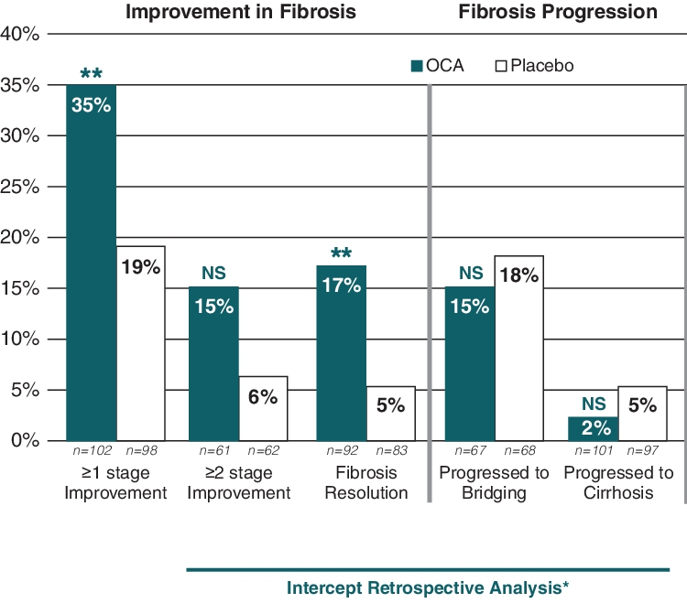
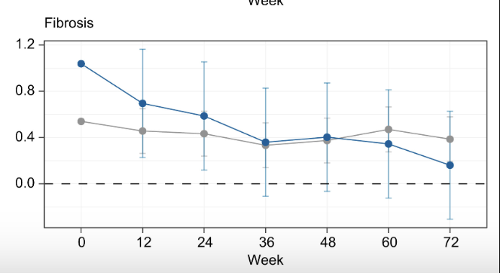
Changes in SomaSignal Fibrosis Test Associated with Anti-fibrotic Efficacy from External Clinical Trial
Mean Logit (predicted probability)
FLINT study: Obeticholic acid vs. placebo

